Slide 1
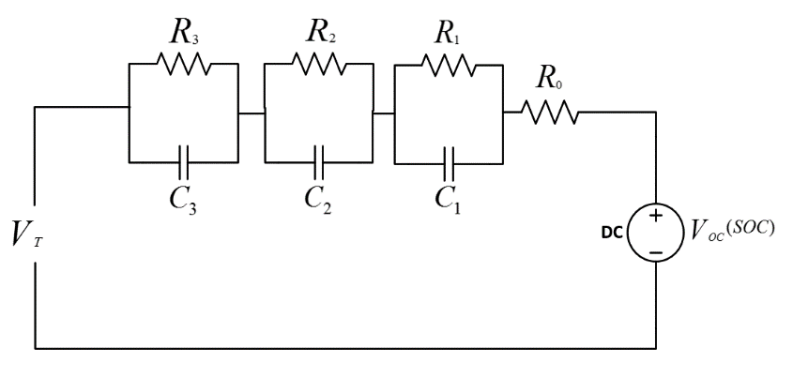

EQUIVALENT CIRCUIT BATTERY MODEL
RC models consists of an Open circuit voltage source which is a function of the battery SOC
$R_{0}$ represents the battery internal resistance while RC branches are used to model battery dynamics
Any of these models can be enhanced by incorporating a hysteresis state to account for battery hysteresis that occurs in charging and discharging

Slide 2
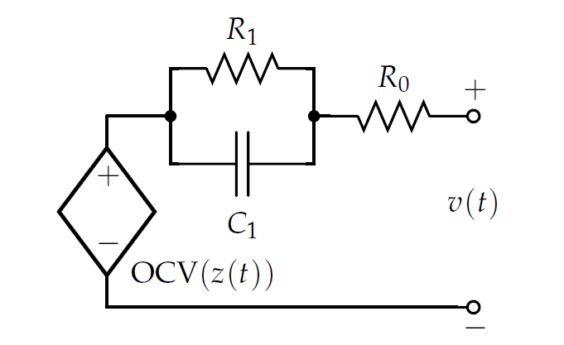
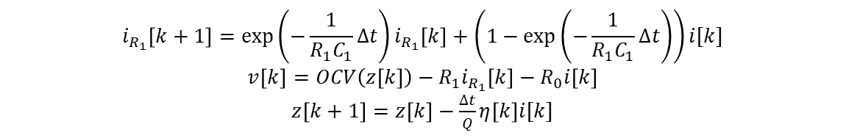



EQUIVALENT CIRCUIT BATTERY MODEL: OCV-RRC
Battery open-circuit voltage (OCV) is a function of its state of charge (SOC)
The OCV-SOC values are stored in a look-up table or in an empirical equation form
$$i_{R_{1}}(t)$$
$$i(t)$$
$$i_{c_{1}}(t)$$
$$i_{R_{1}}\left[k+1\right]=\exp\left(−\frac{1}{R_{1}C_{1}}∆t\right)i_{R_{1}}\left[k\right]+\left(1−\exp\left(−\frac{1}{R_{1}C_{1}}∆t\right)\right)i[k]$$
$$v\left[k\right]=OCV\left(z\left[k\right]\right)−{R_{1}i}_{R_{1}}\left[k\right]−R_{0}i\left[k\right]$$
$z\left[k+1\right]=z\left[k\right]−$ $\frac{∆t}{Q}η\left[k\right]i[k]$
BATTERY MANAGEMENT SYSTEMS, VOLUME I, BATTERY MODELING, G. Plett

Slide 3
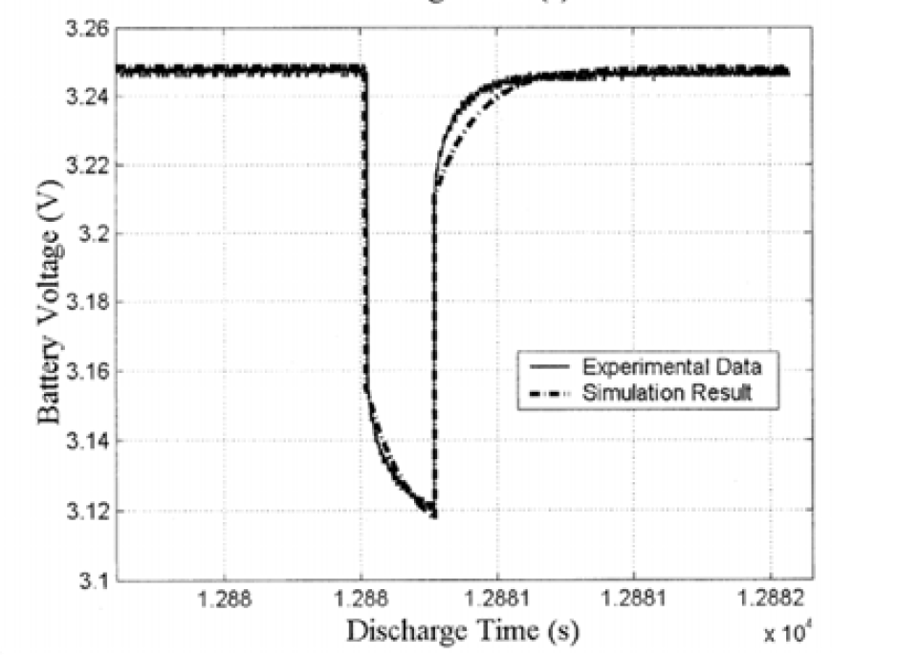



EQUIVALENT CIRCUIT BATTERY MODEL: POLARIZATION
Polarization refers to any departure of the cell’s terminal voltage away from the open-circuit voltage due to a passage of current through the cell
The instantaneous polarization is modeled using $i\left(t\right)× R_{0}$ term
Batteries have more complex behavior, voltage polarization slowly develops over time as current is demanded from the cell, and slowly decays over time when the cell is allowed to rest
The phenomena is caused by slow diffusion processes of lithium in a lithium-ion cell
This slowly-changing voltage as known as diffusion voltage
Response to discharge pulse
$$V\left(t_{0}\right)−V(t_{0}^{+})$$
$$R= \frac{V\left(t_{0}\right)−V(t_{0}^{+})}{I}$$
BATTERY MANAGEMENT SYSTEMS, VOLUME I, BATTERY MODELING, G. Plett

Slide 4
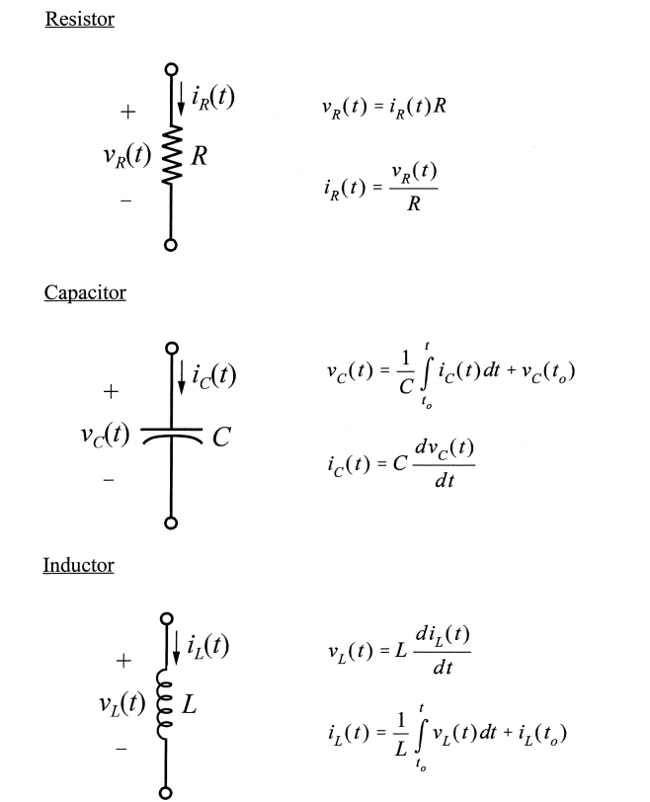
EQUIVALENT CIRCUIT BATTERY MODEL: BASIC CIRCUITS REVIEW
http://www.ece.msstate.edu/~donohoe/ece3183inductance_and_capacitance.pdf

Slide 5
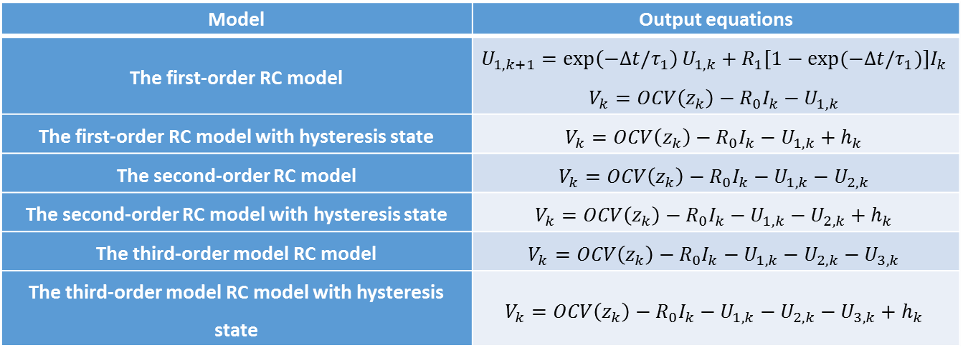
EQUIVALENT CIRCUIT BATTERY MODEL: FIRST/SECOND/THIRD ORDER MODEL
Model | Output equations
The first-order RC model | $$U_{1,k+1}=\exp\left(−∆t/τ_{1}\right)U_{1,k}+R_{1}[1−exp(−∆t/τ_{1})]I_{k}$$ $$V_{k}=OCV\left(z_{k}\right)−R_{0}I_{k}−U_{1,k}$$
The first-order RC model with hysteresis state | $$V_{k}=OCV\left(z_{k}\right)−R_{0}I_{k}−U_{1,k}+h_{k}$$
The second-order RC model | $$V_{k}=OCV\left(z_{k}\right)−R_{0}I_{k}−U_{1,k}−U_{2,k}$$
The second-order RC model with hysteresis state | $$V_{k}=OCV\left(z_{k}\right)−R_{0}I_{k}−U_{1,k}−U_{2,k}+h_{k}$$
The third-order model RC model | $$V_{k}=OCV\left(z_{k}\right)−R_{0}I_{k}−U_{1,k}−U_{2,k}−U_{3,k}$$
The third-order model RC model with hysteresis state | $$V_{k}=OCV\left(z_{k}\right)−R_{0}I_{k}−U_{1,k}−U_{2,k}−U_{3,k}+h_{k}$$

